Slide 1
ME469: High Performance Computing for CFD
Stefan P. Domino^{1,2}
¹ Computational Thermal and Fluid Mechanics, Sandia National Laboratories
² Institute for Computational and Mathematical Engineering, Stanford
SAND2018-4536 PE

Slide 2
High Performance Computing for CFD: Outline
Overview of Time and Length Scales
Fire
Wind
Conceptual Parallel Computing Model
Types of Scaling: Strong and Weak
Examples of Scaling
Next Generation Platform Exascale Drivers
Data Movement vs Data Execution
Conclusions

Slide 3
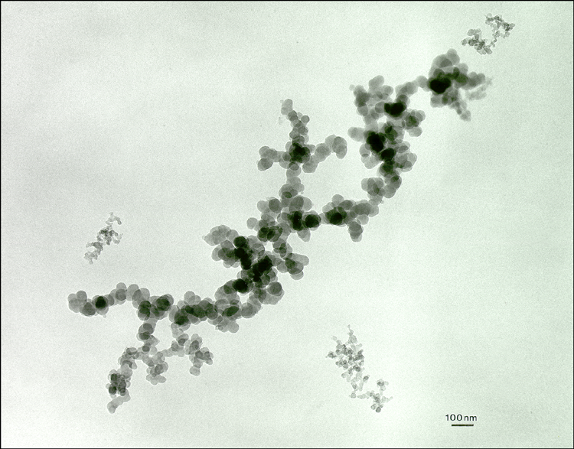
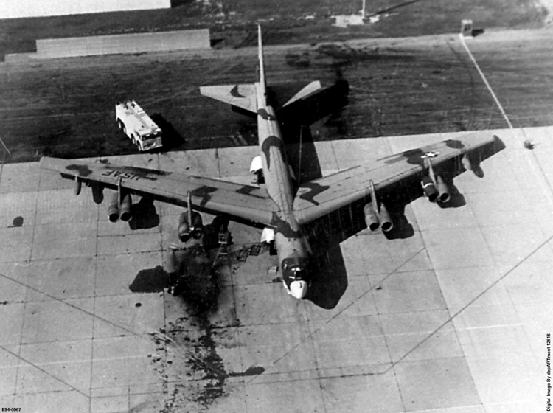
Disparity in Time and Length Scales, Fire
Engineering Scale of Interest
10³
Heat Transfer in Weapon
Convective Transport
10⁰
Convection
Time Scale, seconds
Products
10⁻³
Fuel Distribution
Soot
Flames
10⁻⁶
Soot Radiation
Chemical Kinetics
Diffusive Transport
Soot Growth
10⁻⁹
Molecular Radiation
Molecular Transport
10⁻¹²
10⁻¹⁰
10⁻⁸
10⁻⁶
10⁻⁴
10⁻²
10⁰
10²
Length Scale, meters

Slide 4
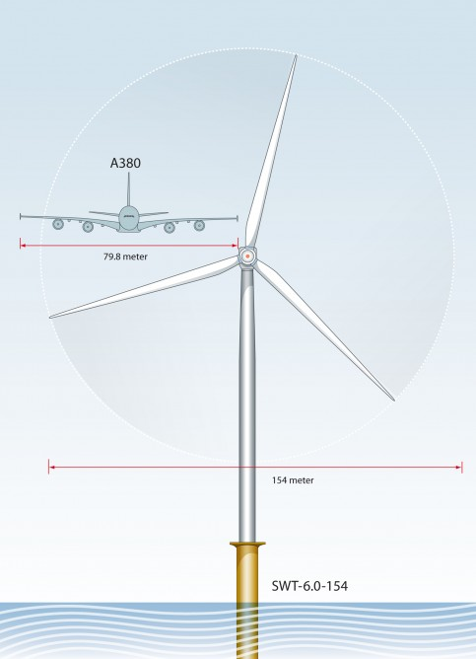
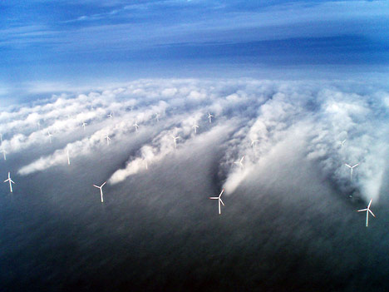
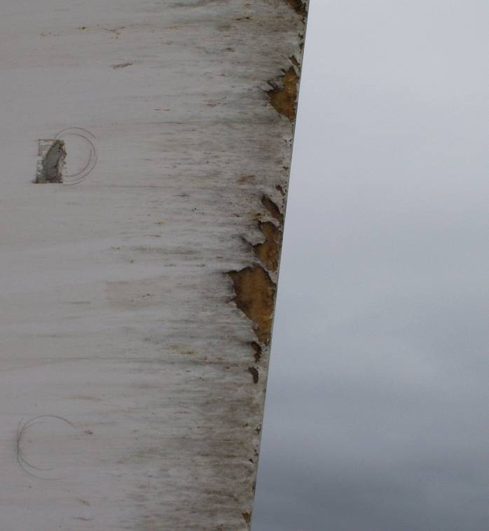
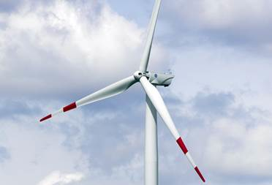
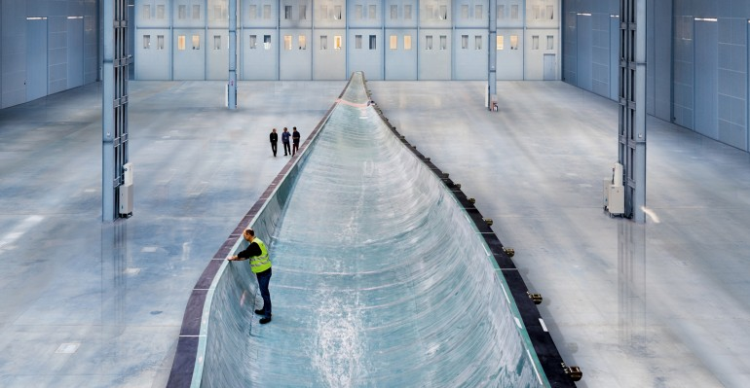
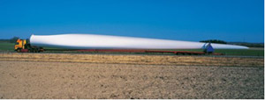
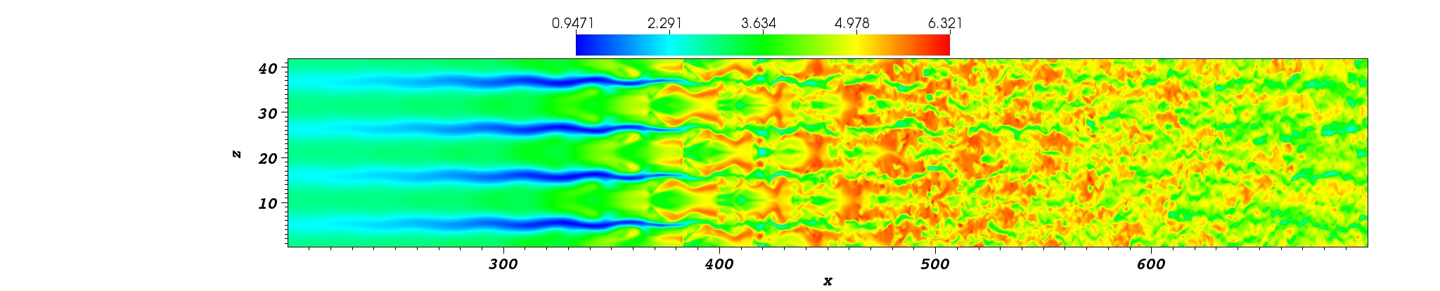
Disparity in Time and Length Scales, Wind
10³
Engineering Scale of Interest
Knight & Carver
Convective Transport
10⁰
Time Scale, seconds
Severe Leading Edge Erosion
10⁻³
Sound propagation (turbulent atmosphere and complex domains)
10⁻⁶
10⁻⁶
10⁻⁴
10⁻²
10⁰
10²
10⁴
Length Scale, meters

Slide 5
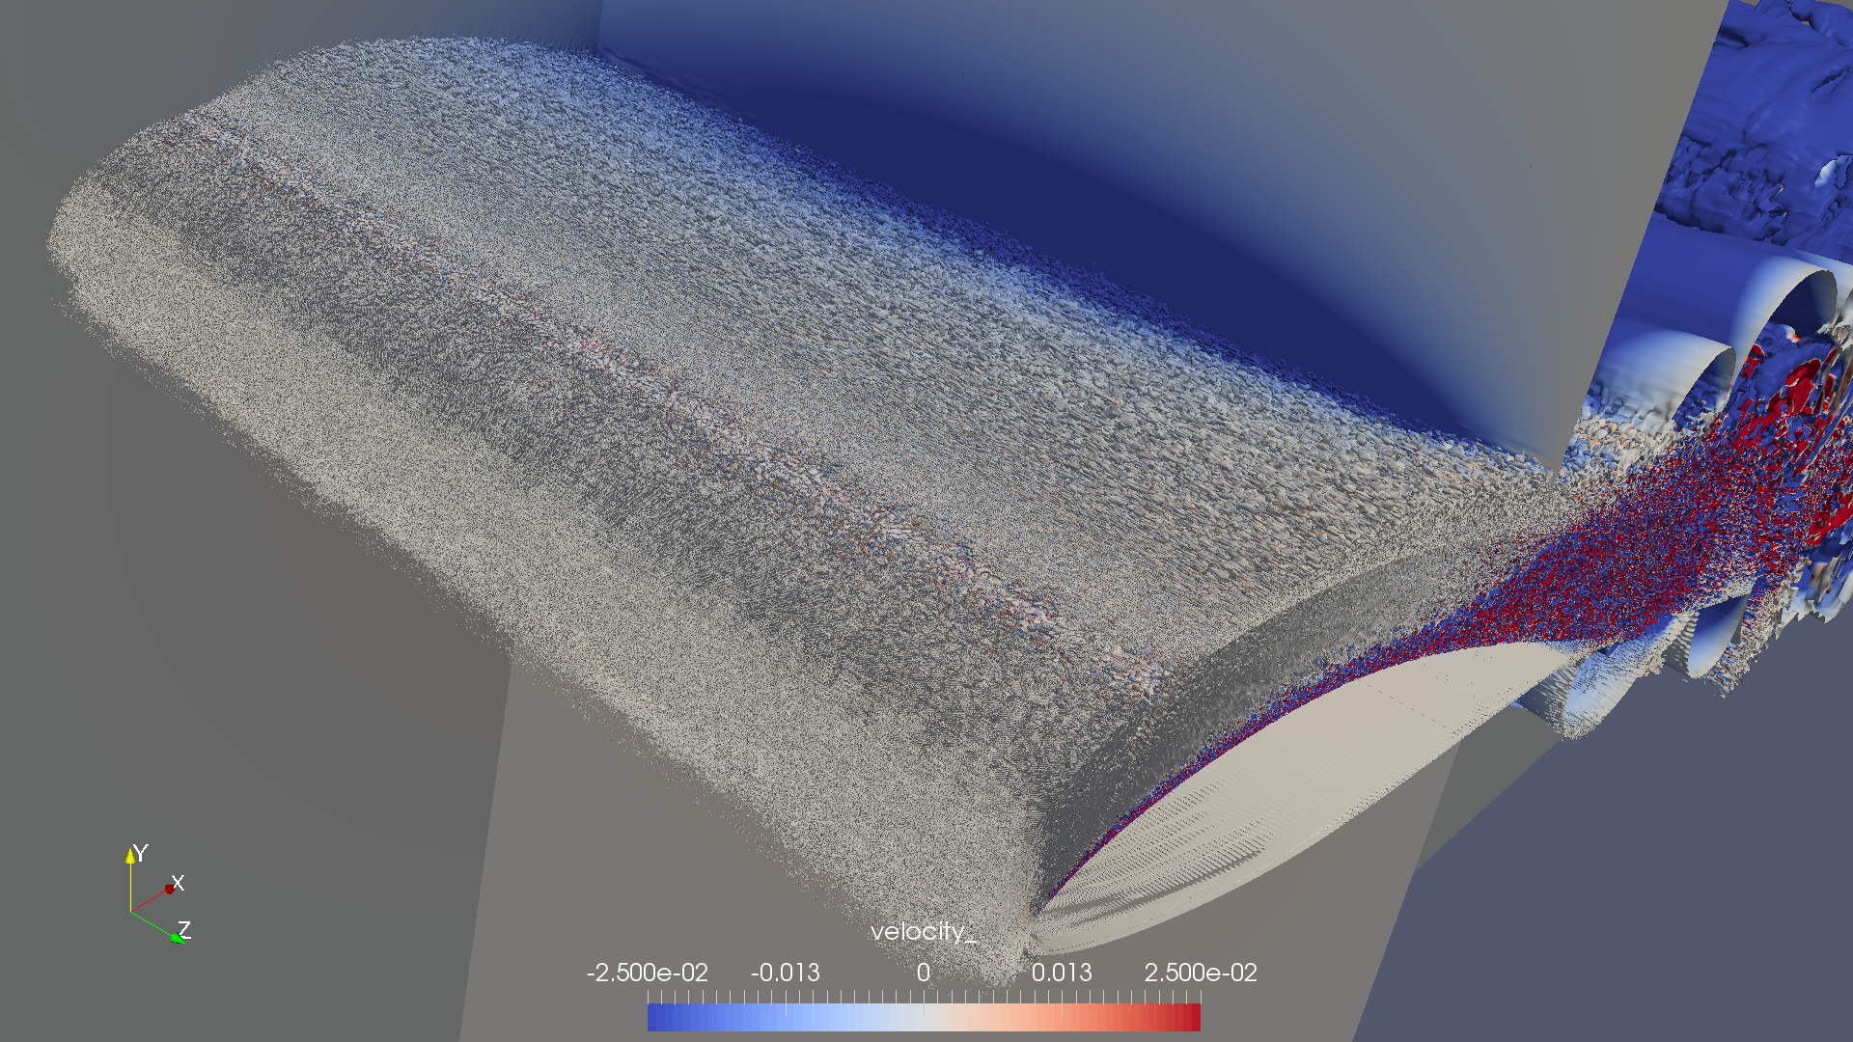
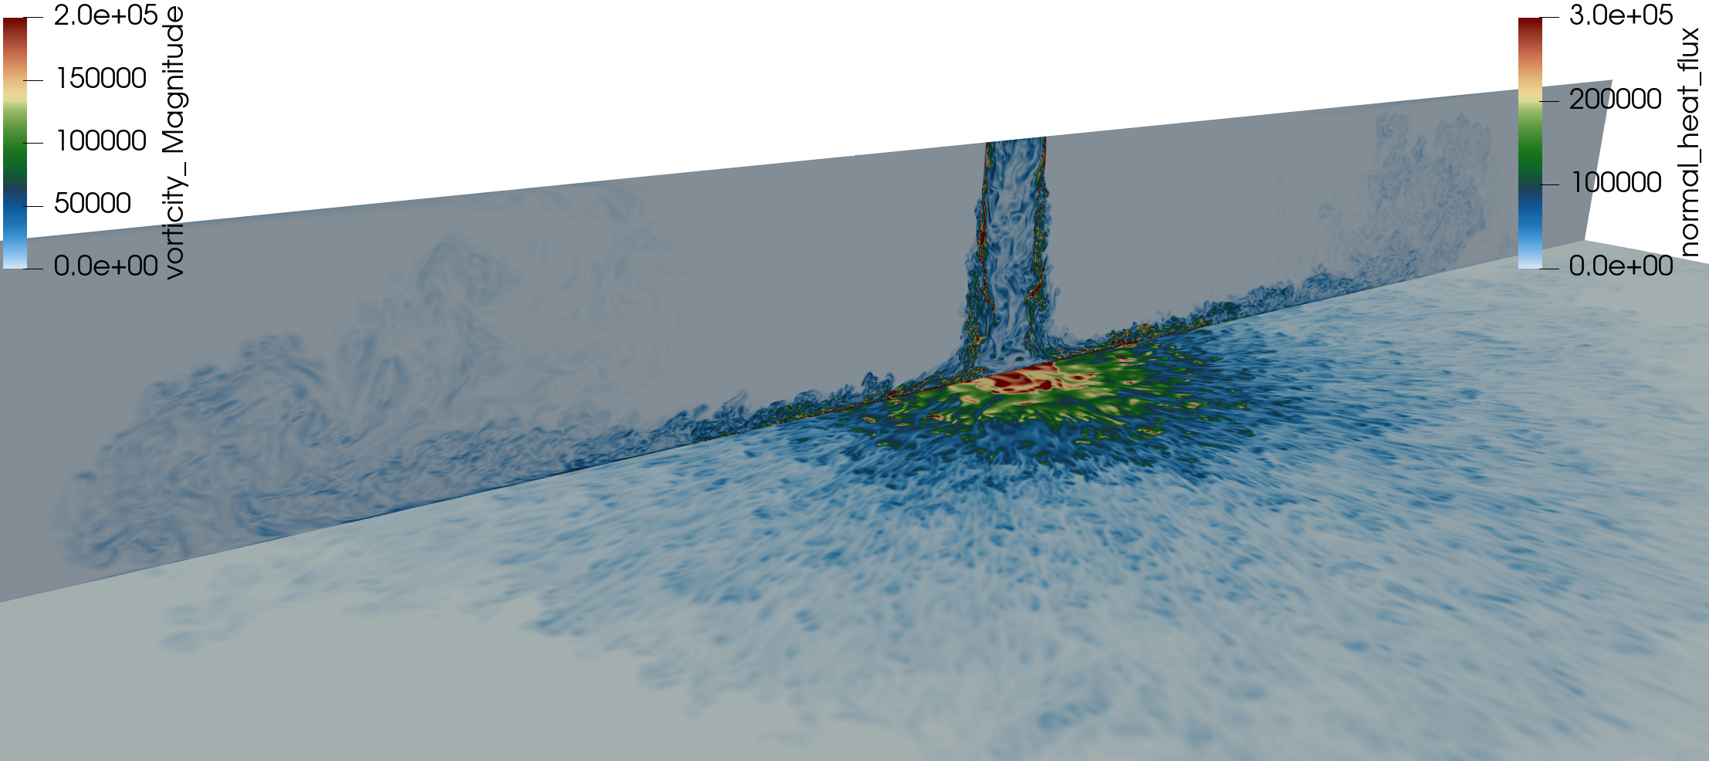
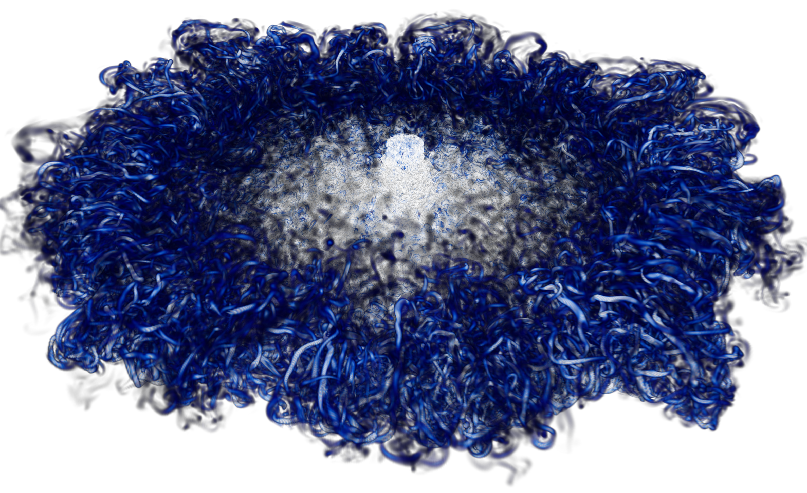
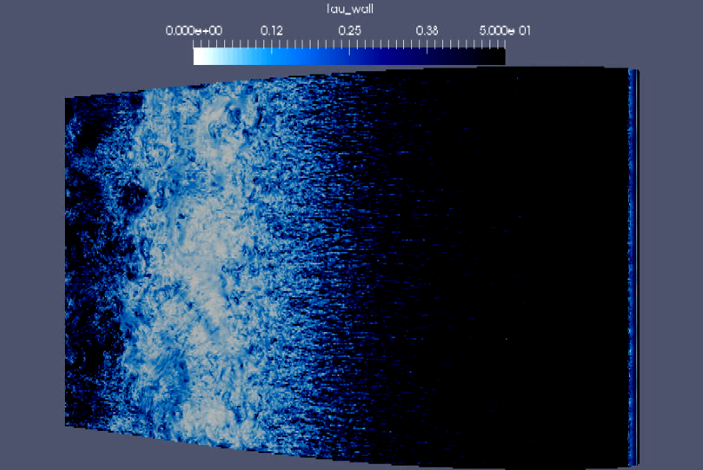
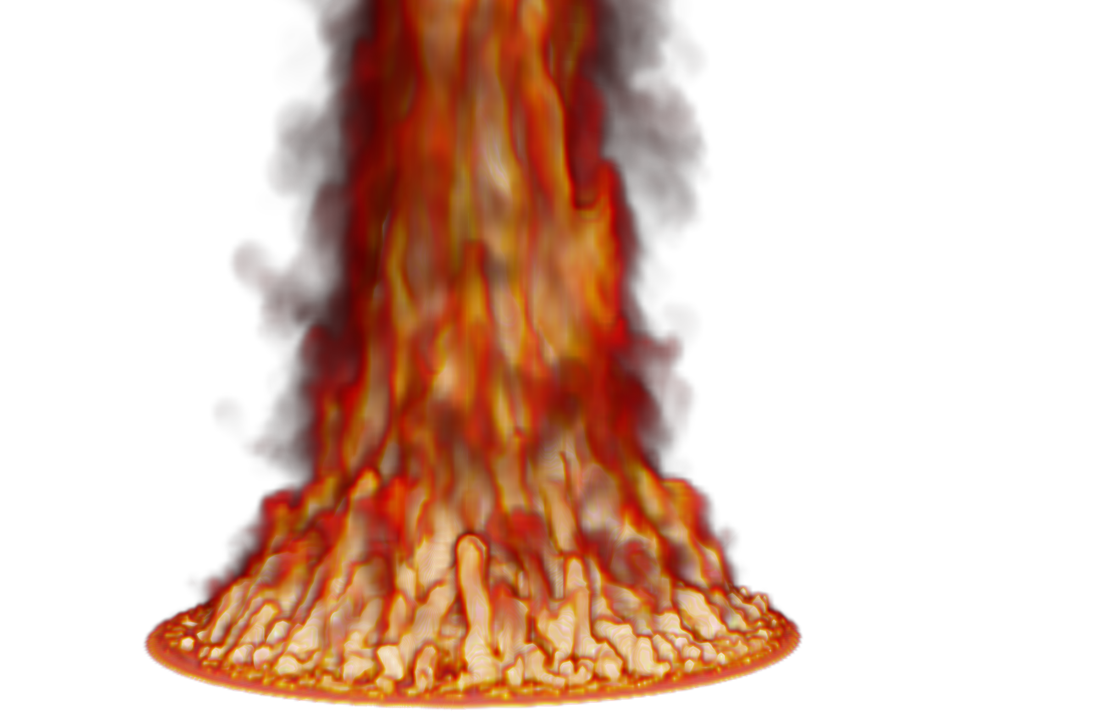
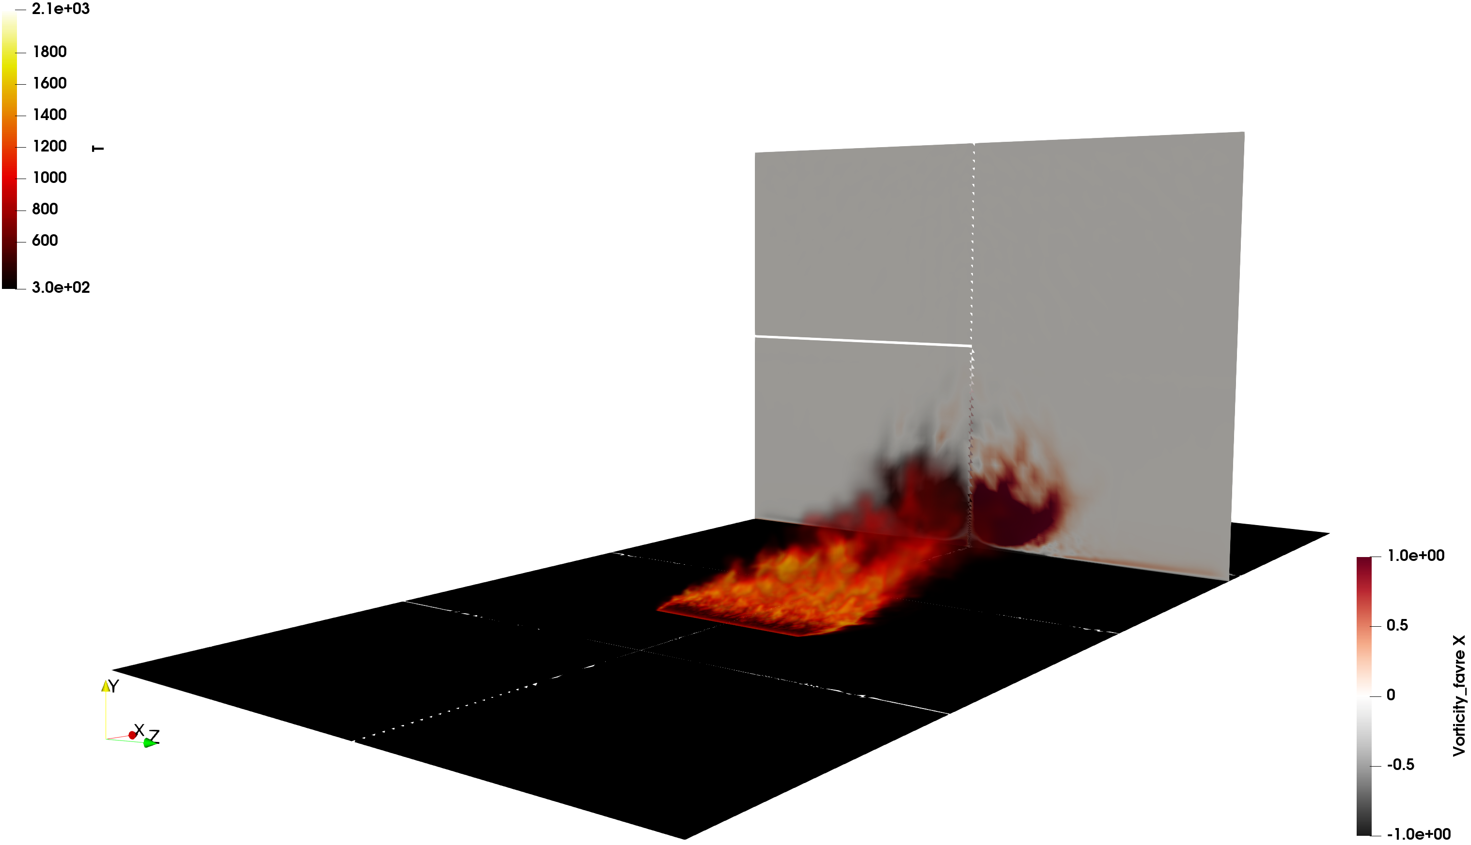

Routine Examples of HPC
O(2) billion DNS impinging jet, velocity (vertical) and heat flux; Q-criterion
O(6) billion wind energy application
O(200) million multi-physics fire

Slide 6
Conceptual Scaling Exercise
= 500 sq ft/day
Goal: Paint a house in one day
My House: 1000 sq ft
WH: 60,000 sq ft
One person would paint my house in two days (!!)
The white house will require one person 120 days (!!)
= 500 sq ft/day
Painting Rate Legend

Slide 7
Single House, More People (each person with reduced load)
= 500 sq ft/day
Goal: Paint a house in one day
My House: 1000 sq ft
WH: 60,000 sq ft
= 500 sq ft/day
Painting Rate Legend
+
= One day
+
+
+
= Faster Completion; Half day (each person 250 sq ft)

Slide 8
White House, More People (with shared load)
= 500 sq ft/day
Goal: Paint a house in one day
My House: 1000 sq ft
WH: 60,000 sq ft
= 500 sq ft/day
Painting Rate Legend
( )
Time to completion is one day. Everyone
involved provided 500 sq ft
= 1 day
+
= 60 days
60x
+

Slide 9

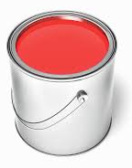

Single House, More People (with impediments)
= 500 sq ft/day
Sam’s team, who played basketball last night, have some injuries
Limited paint brushes…
Plenty of paint, poor loading capacity
No coherent plan of attack
= 500 sq ft/day
Painting Rate Legend
~ 250 sq ft/day
…
( )
+
= 60 days
60x
+
+
>> 1 day
n

Slide 10
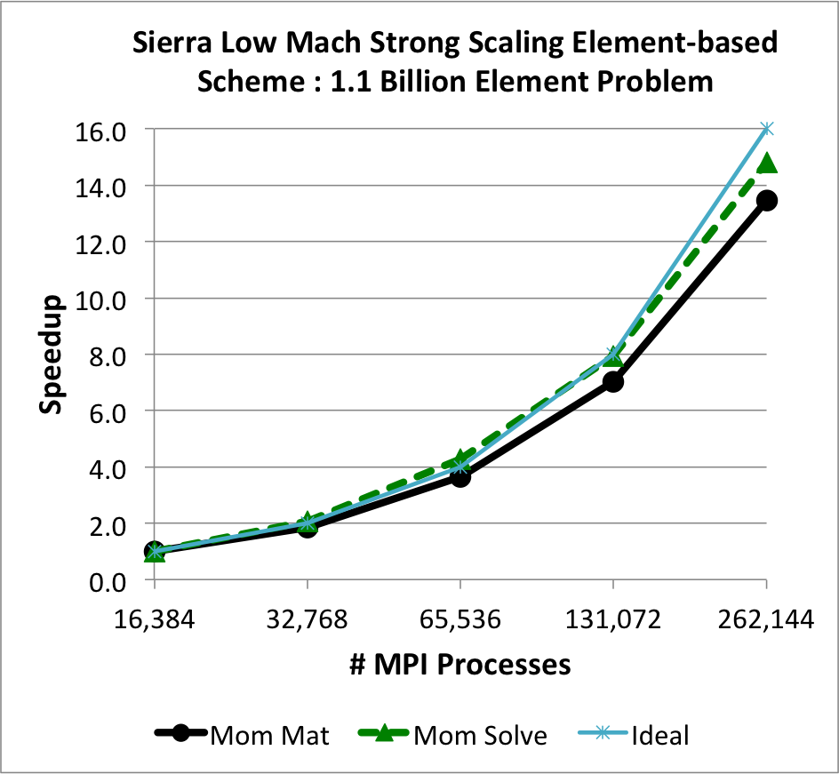
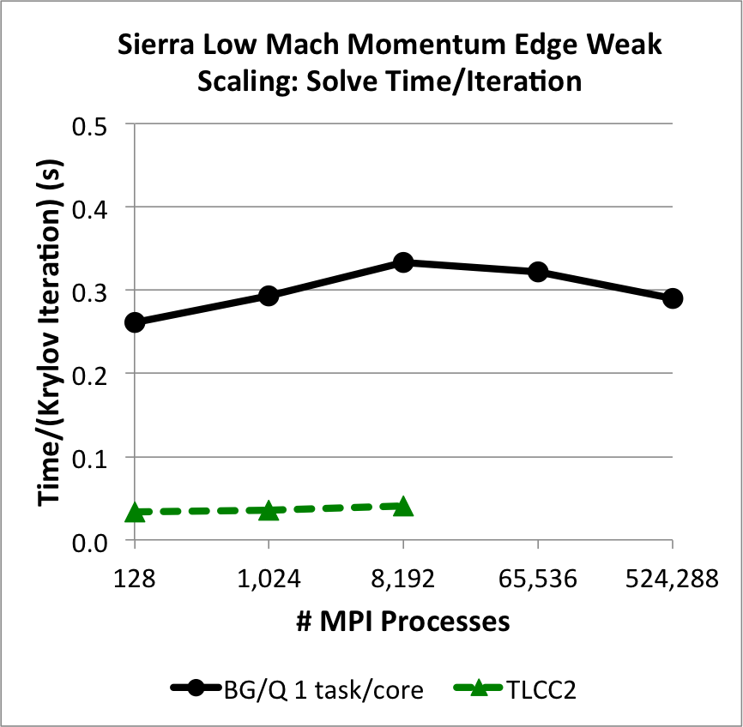
Types of Scaling
Strong Scaling: How the solution time varies with increased computational resources (cores, threads, GPU/Warps) on a fixed-size problem
User Y has a mesh that is 1 billion elements and would like to minimize the time it takes to complete a simulation; the larger the resource, the faster the turn-around
Weak Scaling: How the solution time varies with increased problem size on a fixed computational resource load (cores, threads, GPU/Warps)
User Y is conducting a validation study that includes three mesh resolutions, which were obtained by uniform mesh refinement, and would like to increase the computational resource appropriately for each subsequently refined mesh

Slide 11
Types of Scaling
~4,000 elem/core
~8,000 elem/core
Strong Scaling: How the solution time varies with increased computational resources (cores, threads, GPU/Warps) on a fixed-size problem
User Y has a mesh that is 1 billion elements and would like to minimize the time it takes to complete a simulation; the larger the resource, the faster the turn-around
Weak Scaling: How the solution time varies with increased problem size on a fixed computational resource load (cores, threads, GPU/Warps)
User Y is conducting a validation study that includes three mesh resolutions, which were obtained by uniform mesh refinement, and would like to increase the computational resource appropriately for each subsequently refined mesh
General Implicit Guidelines:
1e6 elem/node
~25k elem/core

Slide 12
Challenges Associated with Scaling
Consider a communication-intensive code procedure: Algebraic Multigrid (AMG) preconditioner setup
Hierarchy of parallel
Point-to-point communications
Like verification, the product of a first-time scaling study at a new production scale is generally met with work!

Slide 13
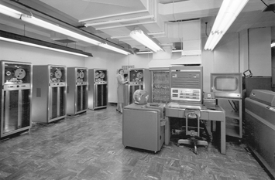
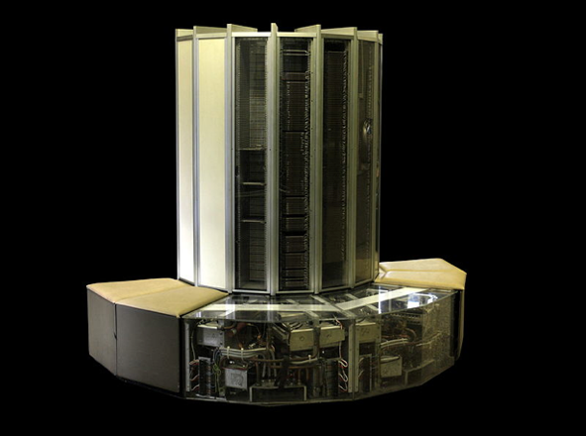
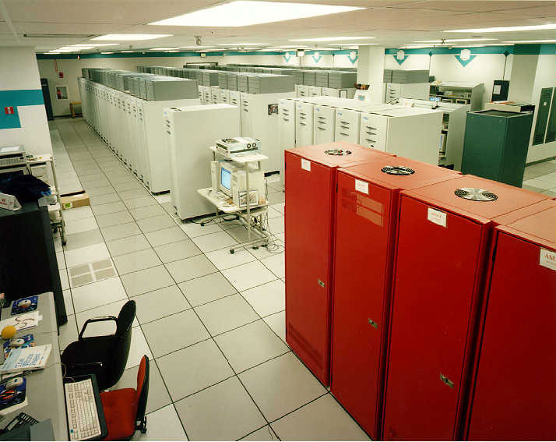
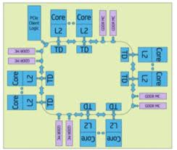
Computing Performance: Through the Years
HPC is facing a new disruption in technology
HPC is facing a new disruption in technology
Mainframes
60’s to 70’s
Vector
Supercomputers
70’s to early 90’s
Massively parallel processor (MPP) systems with simple nodes
1990’s to 2010
MPP w/ Advanced Architecture nodes: Multilevel, heterogeneous, energy and memory constrained
ROOM → MACHINE → CABINET → CHIP
COMPLEXITY
Technology disruptions require a significant increase in complexity of our codes
Slides courtesy of Mike Glass, Jim Ang, Rob Hoekstra, Si Hammond, Ron Brightwell, and Stephen Olivier.

Slide 14
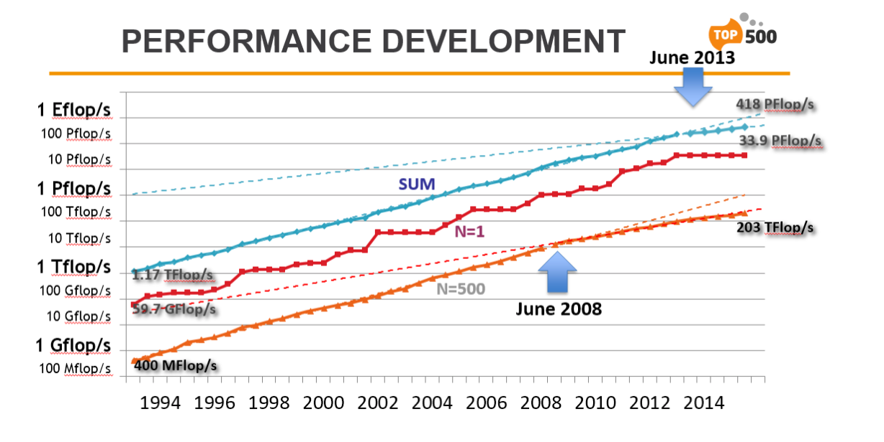
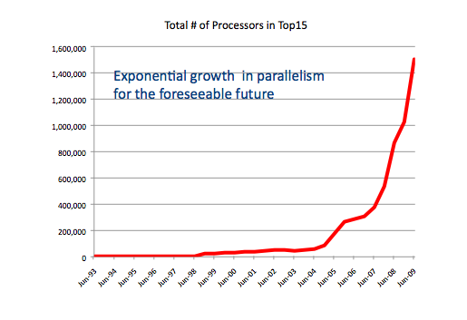
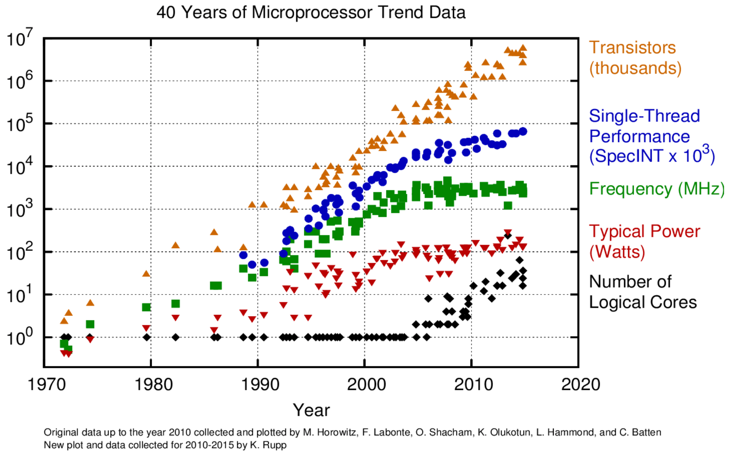
Drive Towards Next Generation Platforms
Dramatic increase in on-node parallelism and reduction in relative data movement is counter to our current code performance
Power constraints are driving the rapid increase in on-node parallelism.
However, per core memory bandwidth is decreasing making it extremely difficult to fully utilize additional cores
Slides courtesy of Mike Glass, Jim Ang, Rob Hoekstra, Si Hammond, Ron Brightwell, and Stephen Olivier.

Slide 15
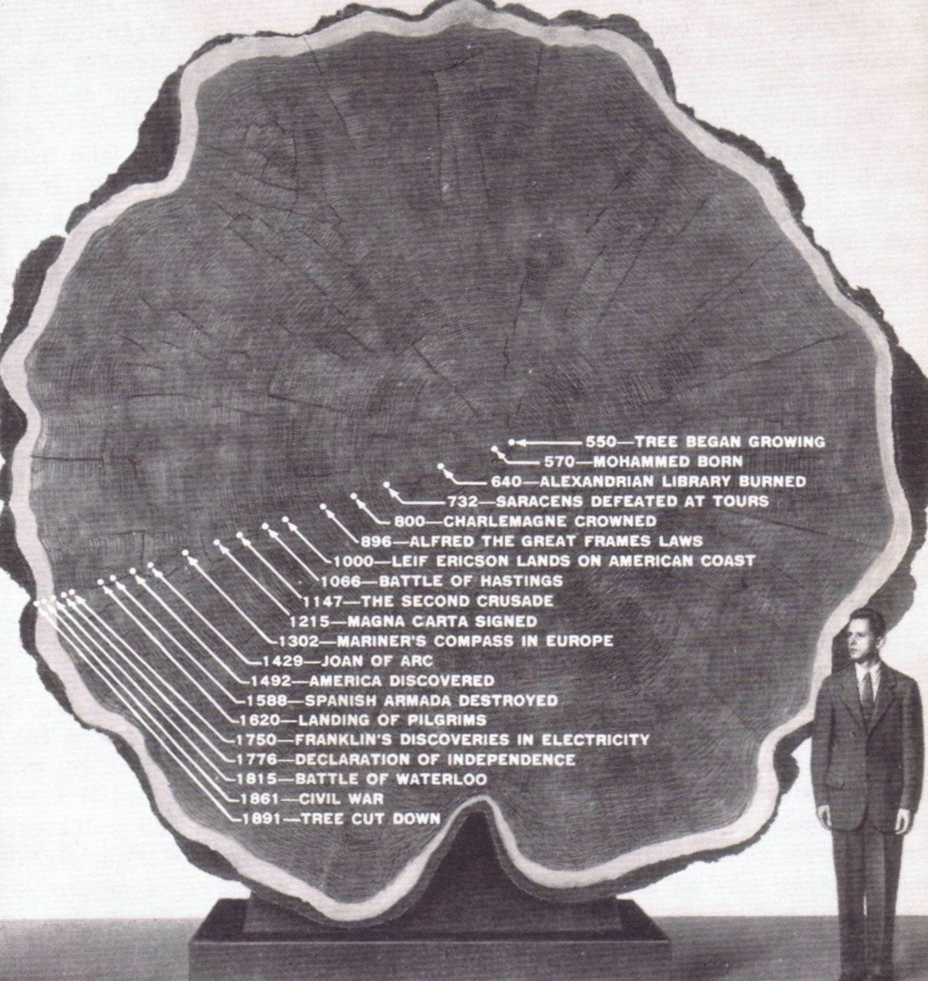
High Performance Computing (HPC): Enabling Scientific Advancement
Late Roman Timeline 250 AD - 300 AD
250 AD: The Goths invade Anatolia (AKA, Asia Minor), in sea-borne raids they plunder Nikopolis
Trinity open-science Domino and Barone, SAND2016-4085C (2016) to elucidate stall cells
O(6) billion element wind energy application (high-Re flow past thick blade in high AoA
O(128,0000) core run for ~one week ~1800 year simulation using computing resources available 10-years ago: Complete in roughly 29 years!
Recent impinging jet study: 200,000,000 CPU hours (~23,000 years)
25C, 100C, 300C, and 600C case run on 2000-4000 nodes (32 and 64 mpi ranks/node)
GPU-based approaches now emerging
A giant at redwood tree illustrating the passage
of time within its’ growth rings
Lin et al., Parallel Proc. Letters, (2014)

Slide 16
Parallel Strategies: Option 1
Sierra Toolkit/Standard Ownership rules: Mesh object (nodes, edges, faces, elements) owned by lower-rank. For example:
P0 locally owns E1 and nodes 1, 2, 4, and 5
P1 locally owns E2, E3, and E4 and nodes 3, 6, 7, 8, and 9
P0 and P1 share nodes 2, 4, and 5
Desired Control-Volume Finite Element (CVFEM) Operation:
“nodal volume” assemble for node 5 via iteration of each 1cmx1cm element. Desired nodal volume for node 5 = 1 cm² exactly the same on both parallel ranks
Options:
1. Iterate over locally owned elements and locally accumulate nodal volume field followed by a parallel sum and copy owned to shared.
2. Ghost element E2, E3, and E4 to P0 and E1 to P1 (along with coordinates) and iterate locally owned and ghosted elements. Locally accumulate nodal volume field followed by a copy owned to shared.
P0
1
2
3
face 1
E1
E2
4
edge 1
5
edge 2
6
E3
E4
7
8
P1
9

Slide 17
Parallel Strategies: Option 1
Sierra Toolkit/Standard Ownership rules: Mesh object (nodes, edges, faces, elements) owned by lower-rank. For example:
P0 locally owns E1 and nodes 1, 2, 4, and 5
P1 locally owns E2, E3, and E4 and nodes 3, 6, 7, 8, and 9
P0 and P1 share nodes 2, 4, and 5
Desired Control-Volume Finite Element (CVFEM) Operation:
“nodal volume” assemble for node 5 via iteration of each 1cmx1cm element. Desired nodal volume for node 5 = 1 cm² exactly the same on both parallel ranks
Options:
1. Iterate over locally owned elements and locally accumulate nodal volume field followed by a parallel sum and copy owned to shared.
2. Ghost element E2, E3, and E4 to P0 and E1 to P1 (along with coordinates) and iterate locally owned and ghosted elements. Locally accumulate nodal volume field followed by a copy owned to shared.
P0
1
2
3
face 1
E1
E2
¼
¼
4
edge 1
5
edge 2
6
¼
¼
E3
E4
7
8
P1
9

Slide 18
Parallel Strategies: Option 2, A View from P0
P0
1
2
3
All work performed on P0
Ghosting and communication required
No parallel sum (think about a matrix entry)
E1
E2
4
5
6
E3
E4
7
8
P1
9
Ghost P1 -> P0

Slide 19
Parallel Strategies: Option 2, A View from P1
P0
1
2
3
All work performed on P1
Ghosting and communication required
No parallel sum (think about a matrix entry)
E1
E2
4
5
6
E3
E4
7
8
P1
9
Ghost P0 -> P1

Slide 20

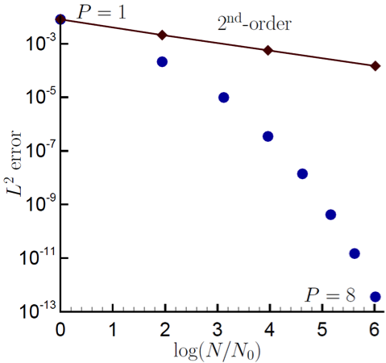
Conceptual Disparity Between Low- and High-Order
Recall, that for unstructured schemes, increased connectivity to achieve a higher-order basis is difficult
However, we have discussed a notion of “polynomial promotion” of the underlying basis that provides higher-order convergence
Dual-volume for promoted quad4
Spectral convergence

Slide 21
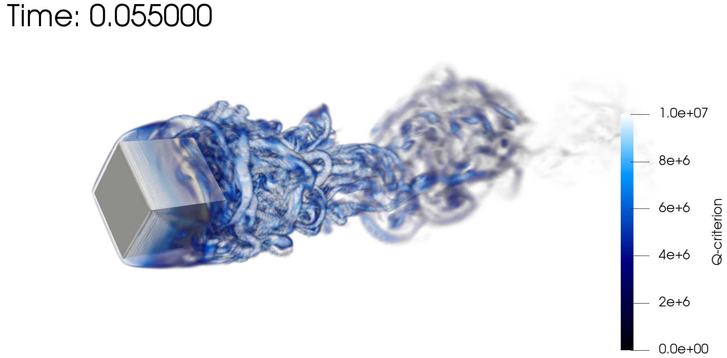
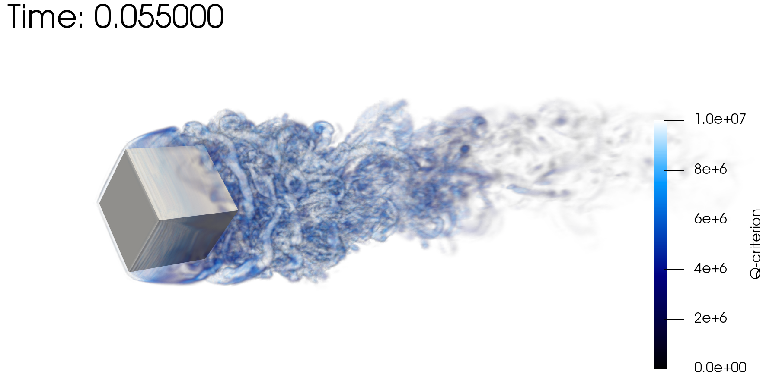
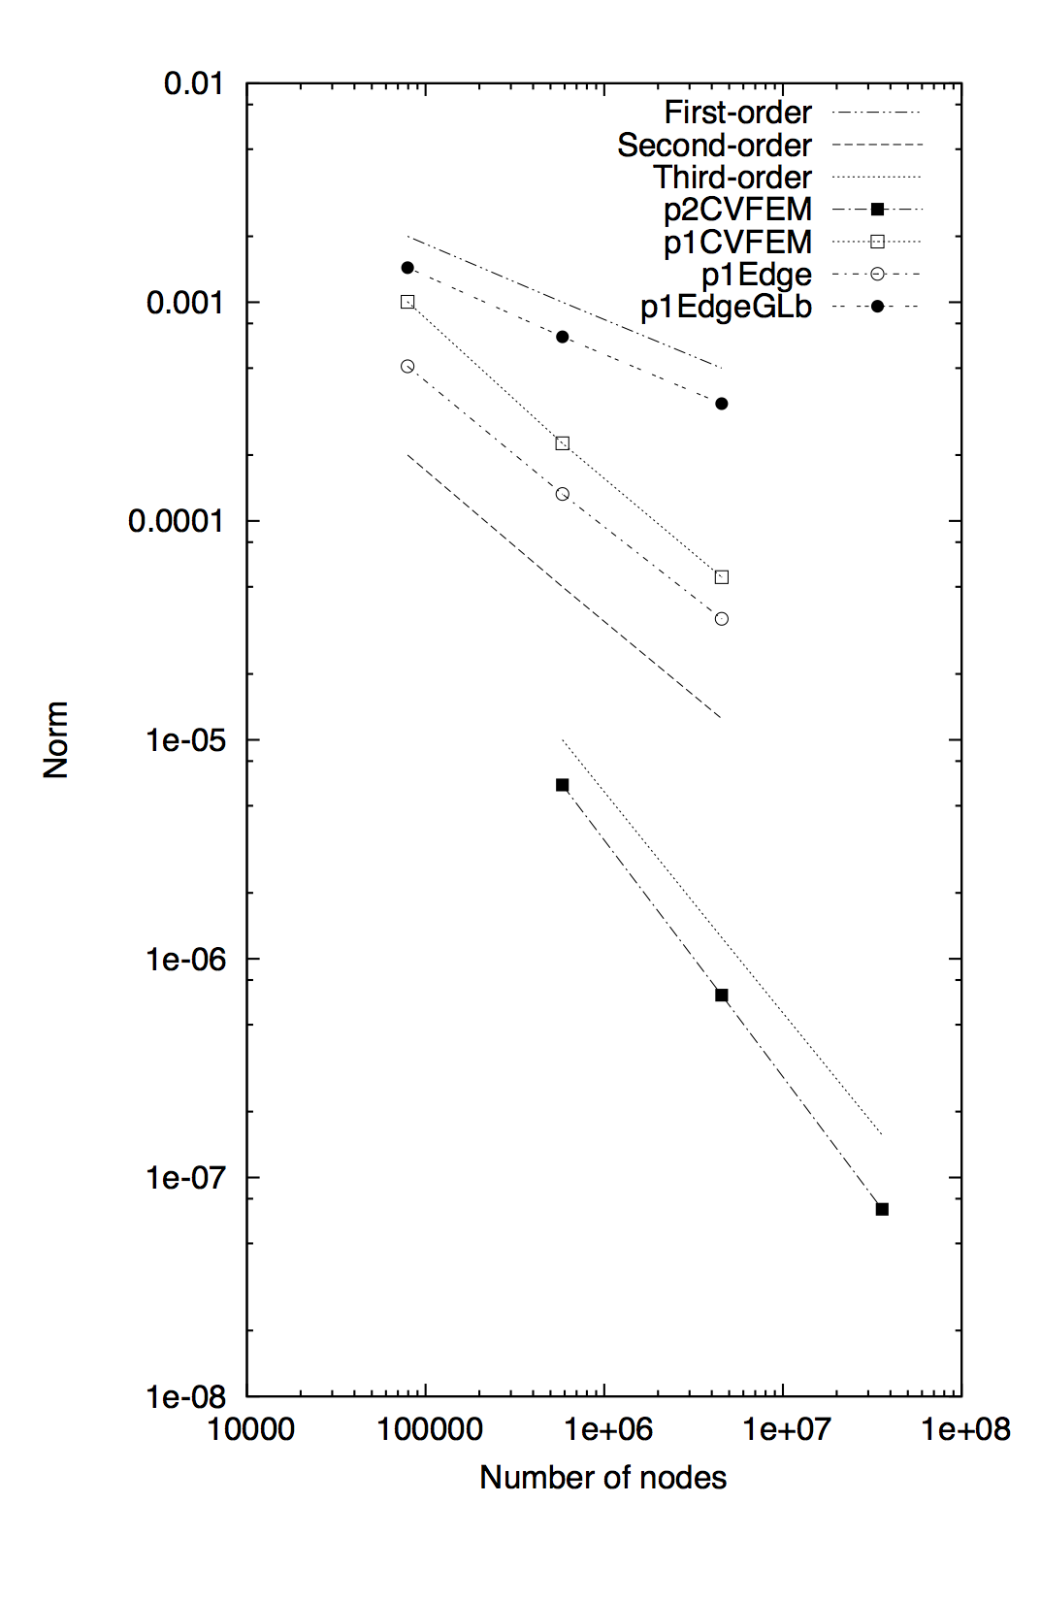
Work!
Obviously, the promoted element has far more nodes
Gauss-Lobatto: nodes
Gauss-Legendre: sub-control surfaces
Rotating cube (Re 4000, RPM 3600) P=1 (top) and P=2 (bottom)

Slide 22
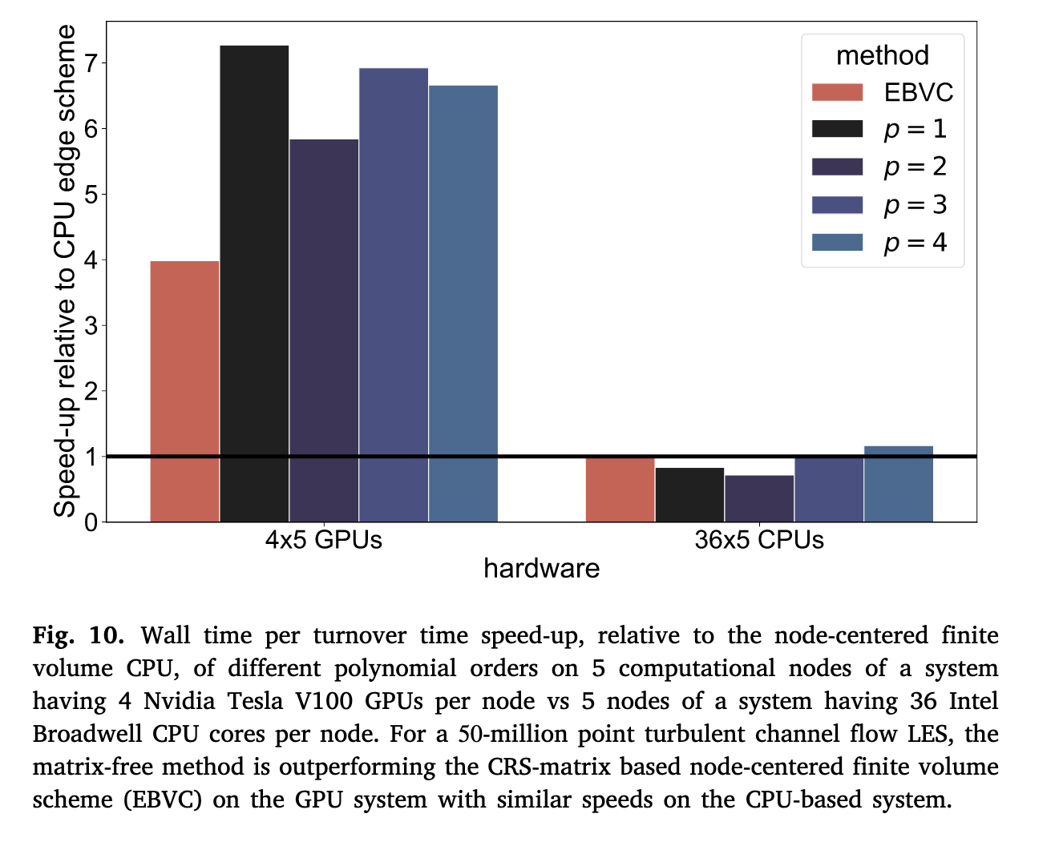
Timely Publications on Next Generation Platforms
Knaus, Robert. 2022. “A Fast Matrix-Free Approach to the High-Order Control Volume Finite Element Method with Application to Low-Mach Flow.” Computers & Fluids, https://doi.org/10.1016/j.compfluid.2022.105408

Slide 23
High Performance Computing for CFD: Conclusions
Several fluids applications found in the low-Mach application space require HPC
Strong and weak scaling are of interest in engineering analysis
Communication bottlenecks can affect scaling
From a user-perspective, scaling is critical to efficiently deploying production simulation results
Path towards NGP will require disruptive technology with significant code investments

